Slide 1
British airways
Predicting customer buying behaviour

Slide 2
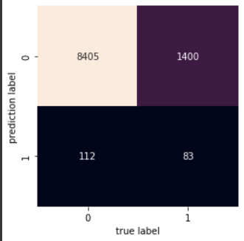
Random forest model
The confusion matrix shows that our model is good at predicting which customer will not buy ticket from us

Slide 3
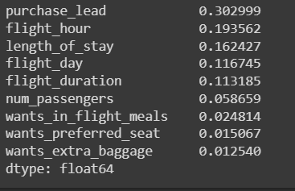
Important features
Random Forest model had generated information about how each variable within the model contributes to its predictive power.

Slide 4
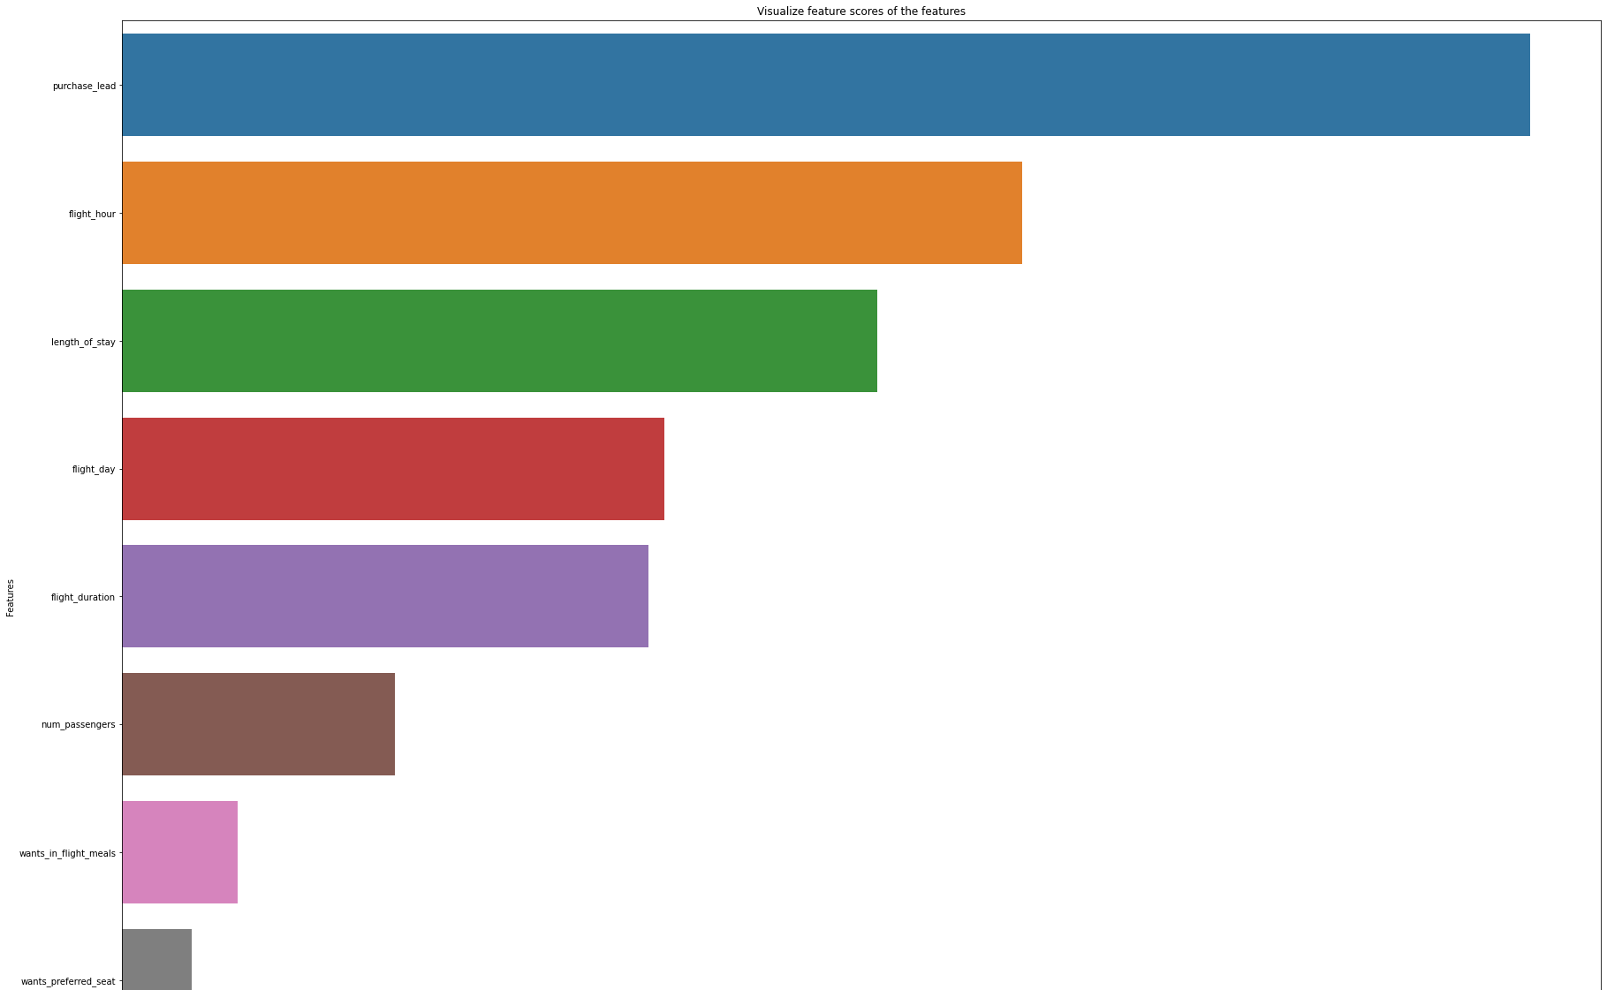
Purchase_lead
Flight hour
Length of stay
Flight day
Flight duration
Nums passengers
Wants in flight meals
Wants preferred seat

Slide 5
Summarise
As conclusion, we could predict our potential customer and their behaviour based on flight hour, length of stay during vacation and number of days between travel date and booking date (purchase lead).

